Slide 1
Lec.4 Dynamic Modeling
Instructor : Prashant Mishra
BIAS Bhimtal

Slide 2
The dynamic model
The dynamic model shows the time-dependent behavior of the system and the objects in it. Events can be defined as “something happened at a point of time”. The dynamic model is important for interactive systems. The logical correctness of events depends on the sequences of interactions, or sequence of events.
Dynamic model describes those aspects of the system that changes with the time. It is used to specify and implement control aspects of the system. It depicts states, transitions, events and actions. The dynamic model includes event trace diagrams describing scenarios.
You can understand a system by first looking at its static structure, the structure of its objects, and their relationships over time. Aspects of a system that are concerned with time and changes are the dynamic models.

Slide 3
Control describes the sequences of operations that occur in response to external stimuli without consideration of what the operations do, what they operate on, or how they are implemented.
The major dynamic modeling concepts are events, which represent external stimuli, and states, which represent values of objects. The state diagram is a standard computer science concept (a graphical representation of finite state machines).
Emphasis is on the use of events and states to specify control rather than as algebraic constructs.

Slide 4
EVENTS
An event is simply an occurrence. An event is actually a one way transmission of information from one object to another, but sometimes it may be that an event that occurs on a single object and changes the state of that object.
An event is an external stimulus from one object to another, which occurs at a particular point in time. An event is a one-way transmission of information from one object to another.
Two events can take place at the same time, one after the other, or both the events independently of each other and occurring simultaneously. For example, like two trains can depart at the same time for two different places or two can depart from the same place, but one after the other. It means that the two events can be independent as well as dependent on each other
An object sending an event to another object may expect a reply, but the reply will be a separate event of the second object. So, you may see conversations between two objects as a combination of two or more events.

Slide 5
Event Classes
Every event is a unique occurrence; event class is a name to indicate common structure and behavior. Some events are simple signals, but most event classes have attributes indicating the information they convey. For example, events like train departs which has the attributes train number, class, city, etc. It is not necessary that all the attributes of objects contribute to attributes of events.
Here, you must note that the time at which the event occurs is an implicit attribute of all events.
Some events convey information in the form of data from one object to another. Sometime it may be that some classes of events only signal that something has occurred, while other classes of events convey data values. The data values conveyed by an event are its attributes; it implies that the value of data objects involved in events.

Slide 6
Event class name (attributes)
Sometimes event refers to event instance, or event class.
Mouse button clicked (left click, location)
Digit dialed (digit)
Phone receiver lifted.
Events include error conditions as well as normal occurrences

Slide 7
Scenario
A scenario is seen as a sequence of events that occurs during one particular execution of a system. . Each basic execution of the system should be represented as a scenario. As far as the scope of a scenario is concerned, it varies. It may include all events in the system, or only some events from some selected objects involved in the event. Example of a scenario can be the historical records of executing a system, or a thought experiment of executing a proposed system.

Slide 8
Figure 3.1 shows a scenario to use ATM for withdrawing money

Slide 9
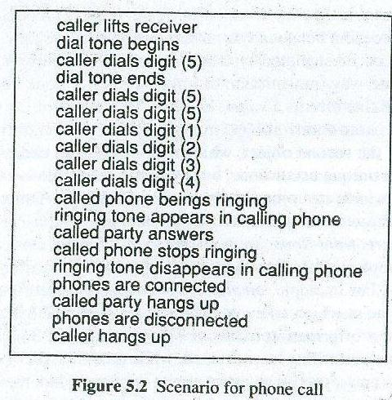

Slide 10
Event-Trace Diagram
The limitation of scenario is that it is not clear from scenario, how many objects are involved and which object generates an event and which object receives an event.
To overcome this limitation, an event-trace diagram is introduced. In the event-trace diagram, the sequence of events and the objects exchanging events both can be shown.
The diagram shows each object as a vertical line and each event as a horizontal arrow from the sender object to the receiver object. Time increases from top to bottom. Spacing between horizontal arrows carries no information.
Figure 3.2 shows the event-trace diagram for interaction with the ATM.

Slide 12
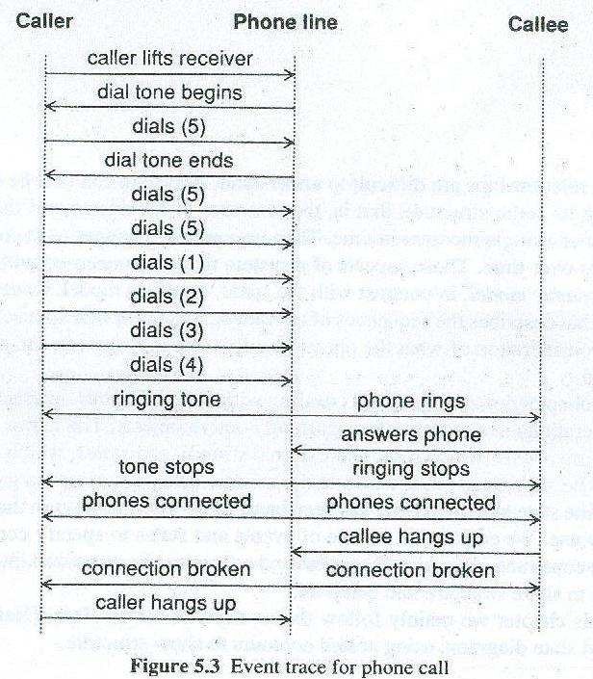
Event Trace For a Phone Call

Slide 13
State Machine
A state machine is a behavior which specifies the sequence of states an object visits
during its lifetime in response to events, together with its responses to those events.
Now, we describe the various concepts related to state machine in the following subsections

Slide 14
STATE
A state is a condition during the life of an object, or an interaction, during which, it satisfies some condition, performs some action, or waits for some event.
An object remains in a state for a finite (non-instantaneous) time.

Slide 15
State
A state corresponds to the interval between two events received by an object and describes the "value" of the object for that time period. A state is an abstraction of an object‘s attribute values and links, where sets of values are grouped together into a state according to properties that affect the general behavior of the object. For instance, stack is empty or stack is full are different states of the object stack. As state corresponds to interval between two events received by an object so it has duration.
A sub state is a state that is nested in another state. A state that has sub states is called a composite state. A state that has no sub states is called a simple state.
Sub states may be nested to any level.

Slide 16
Transition
A transition is a relationship between two states indicating that an object in the first state will, when a specified set of events and conditions are satisfied, perform certain actions and enter the second state. Transition can be self-transition. It is a transition whose source and target states are the same.
If a transition is to a composite state, the nested state machine must have an initial state. If a transition is to a sub state, the sub state is entered after any entry action for the enclosing composite state is executed followed by any entry action for the sub state.
If a transition is from a sub state within the composite state, any exit action for the sub state is executed followed by any exit action for the enclosing composite state. A transition from the composite state may occur from any of the sub states and takes precedence over any of the transitions for the current sub state.

Slide 17
Action
An action is an executable, atomic (with reference to the state machine) computation. Actions may include operations, the creation or destruction of other objects, or the sending of signals to other objects (events). An action is an instantaneous operation. An action represents an operation whose duration is insignificant compared to the resolution of the state diagram. For instance, disconnect phone line might be an action in response to an on-hook event for the phone line. An action is associated with an event.

Slide 18
Activity
Activity is an operation that takes time to complete. An activity is associated with a state. Activity includes continuous operations such as displaying a picture on a television screen as well as sequential operations that terminate by themselves after an interval of time such as closing a valve or performing a computation. A state may control a continuous activity such as ringing a telephone bell that persists until an event terminates it causing the transition of the state. Activity starts on entry to the state and stops on exit. A state may also control a sequential activity such as a robot moving a part that progresses until it completes or until it is interrupted by an event that terminates prematurely.

Slide 19
State Diagram
State diagrams are used to describe the behavior of a system. State diagrams describe all of the possible states of an object as events occur.
Each diagram usually represents objects of a single class and tracks the different states of its objects through the system.
It relates events and states. A change of state caused by an event is called a transition. Transition is drawn as an arrow from the receiving state to the target state.
A state diagram is graph whose nodes are states and whose directed arcs are transitions labeled by event names. State diagram specifies the state sequence
caused by an event sequence.

Slide 20
When to use state diagrams
Use state diagrams to demonstrate the behavior of an object through many use cases of the system. Only use state diagrams for classes where it is necessary to understand the behavior of the object through the entire system. Not all classes will require a state diagram and state diagrams are not useful for describing the collaboration of all objects in a use case. State diagrams are combined with other diagrams such as interaction diagrams and activity diagrams.

Slide 21
state diagram for phone line

Slide 22
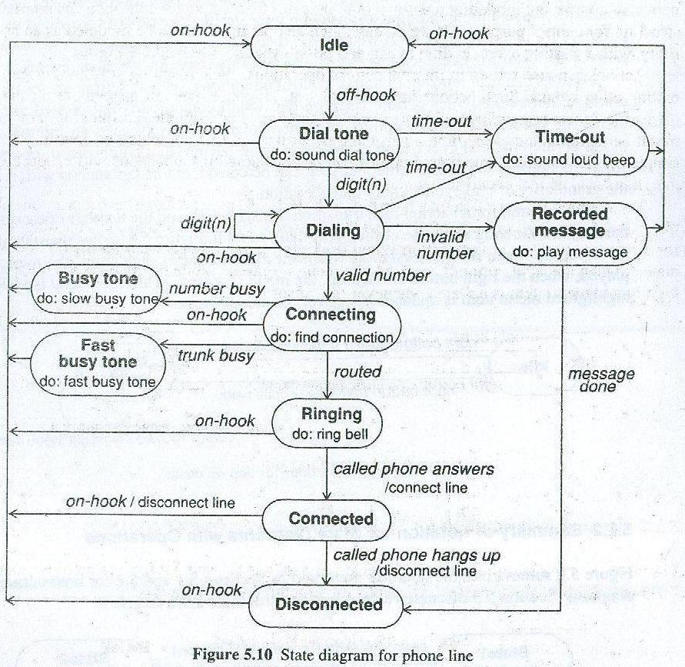

Slide 23
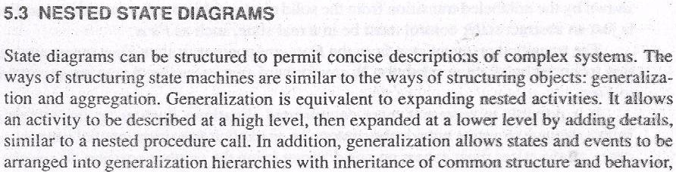
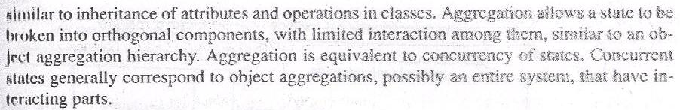

Slide 24
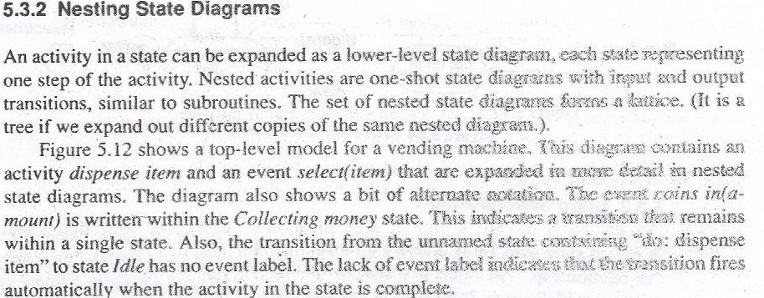

Slide 25
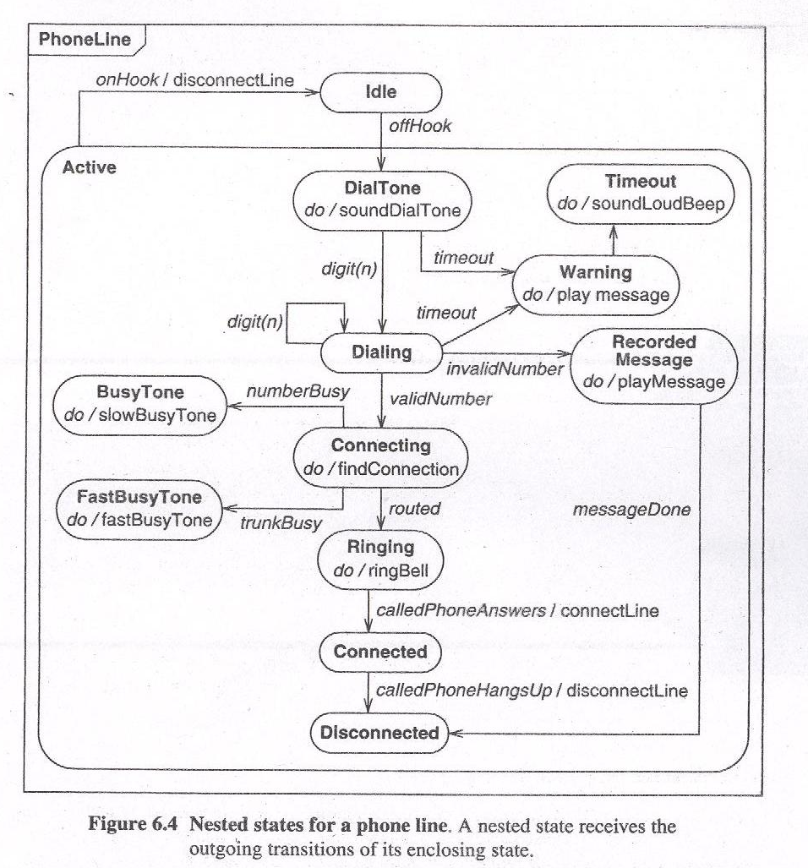

Slide 26
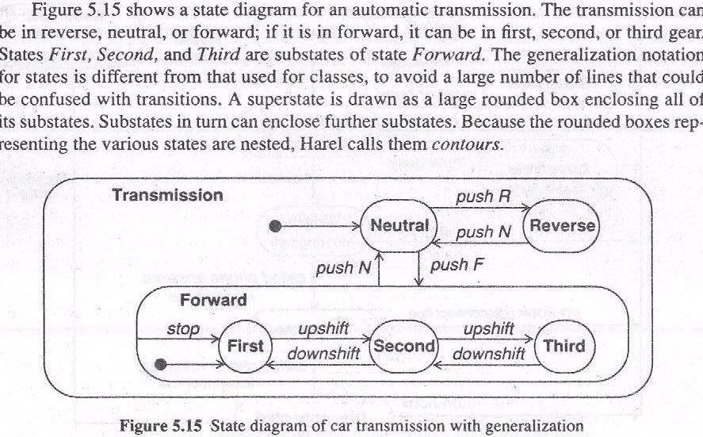

Slide 27
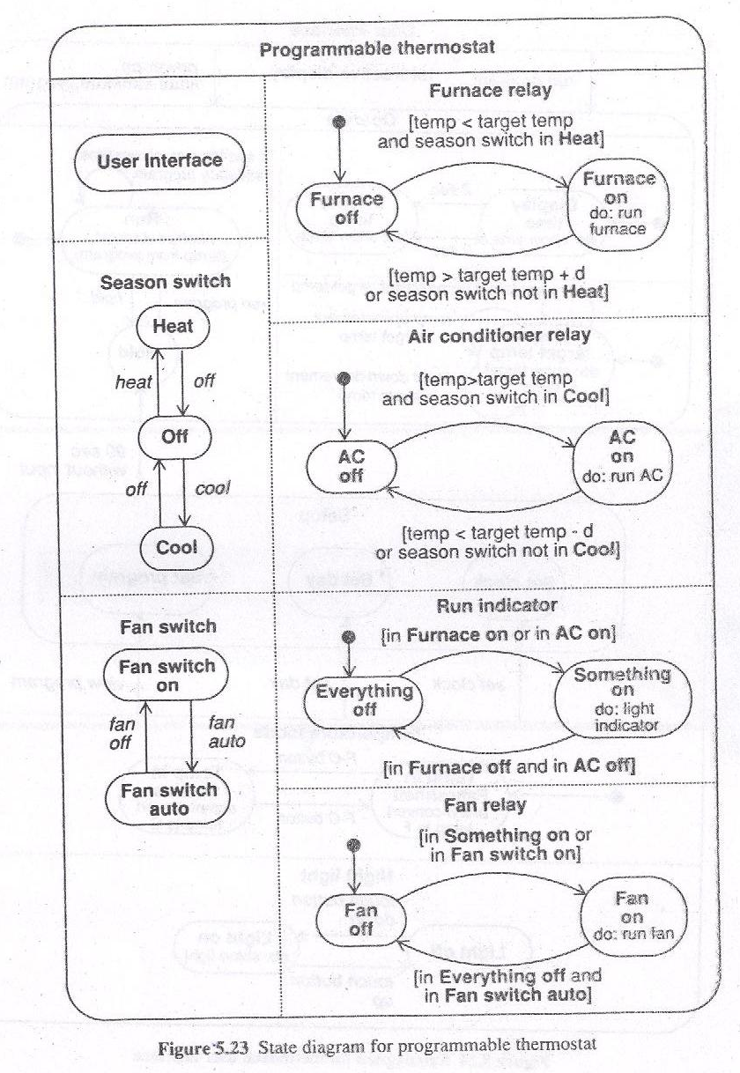

Slide 28
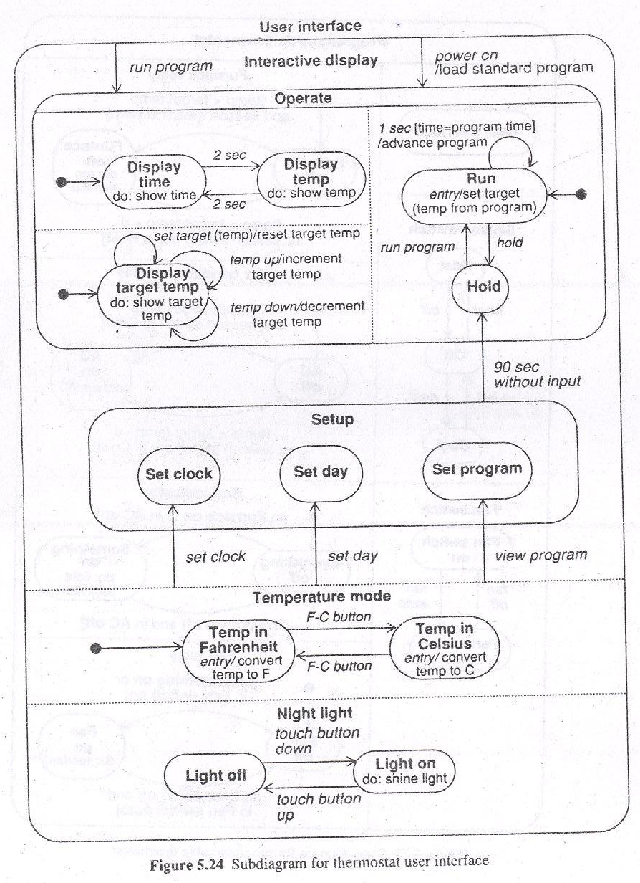

Slide 29
